Slide 1

UNIVERSITY INSTITUTE OF SCIENCES
Academic Unit V
Bachelor of Engineering
(Computer Science & Engineering)
Biology For Engineers
23SZT148
Recombinant DNA Technology
DISCOVER . LEARN . EMPOWER

Slide 2
Recombinant DNA Technology
Stem Cell Biology
Tissue Engineering

Slide 3
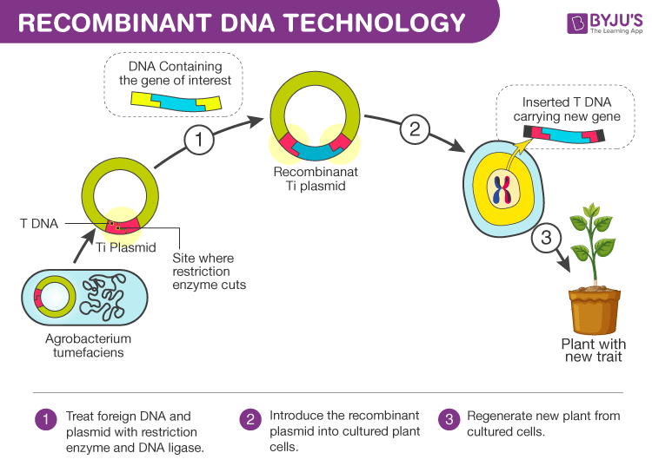

Course Outcome
CO Number | Title | Level
CO1 | Identify the biological concepts from an engineering perspective. | Remember
CO2 | Development of artificial systems mimicking human action. | Understand
CO3 | Explain the basic of genetics that helps to identify and formulate problems | Understand
CO4 | Apply knowledge of measurement system, biomedical recording system and biosensors to excel in areas such as entrepreneurship, medicine, government, and education. | Understand
CO5 | Integrate biological principles for developing next generation technologies | Understand
Will be covered in this lecture
https://byjus.com/biology/tools-recombinant-dna-technology/

Slide 4
SYLLABUS
Unit-3 | Bio Medical Instrumentation | Contact Hours: 15
Chapter 1 Electrical stimulus and biophysical activity Chapter 2 Biomedical recording system Chapter 3 Tissue Engineering | Electrical stimulus and biophysical activity: Patient, electrical shock and hazards, leakage current, Electrical activity of heart (ECG), Electrical activity of brain (EEG), Electrorentinogram (ERG), Electro-occologram (EOG), Electromyogram (EMG). Biomedical recording systems: Basic Recording system, General consideration for signal conditioners Preamplifiers, Differential Amplifier, Isolation Amplifier, Vectorcardiograph, Phonocardiograph, Other biomedical records, Patient isolation, and accident prevention. Tissue Engineering: Recombinant DNA technology, Stem cell biology & Tissue Engineering.

Slide 5
An interdisciplinary field that applies the principles of engineering and life sciences toward the development of biological substitutes that restore, maintain, or improve tissue functions or a whole organ.
Tissue Engineering

Slide 6
Recombinant DNA Technology
Recombinant DNA technology is the joining together of DNA molecules from two different species. The recombined DNA molecule is inserted into a host organism to produce new genetic combinations that are of value to science, medicine, agriculture, and industry.

Slide 7
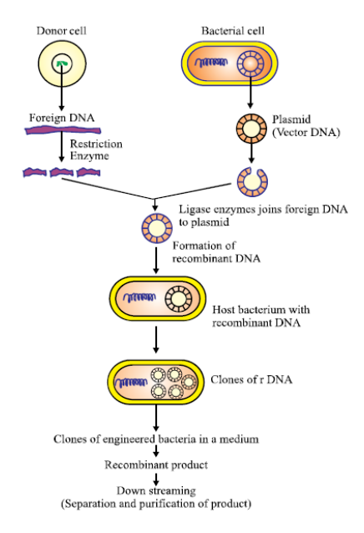
Recombinant DNA technology is the joining together of DNA molecules from two different species.
Recombinant DNA Technology
Using Recombinant DNA technology, we can isolate and clone single copy of a gene or a DNA segment into an indefinite number of copies, all identical.
e.g. Bacterial DNA + human gene for insulin
These new combinations of genetic material or Recombinant DNA (rDNA) molecules are introduced into the host cells, where they propagate and multiply.
The technique or methodology is called Recombinant DNA technology.
The rDNA molecule is inserted into a host organism to produce new genetic combinations that are of value to science, medicine, agriculture, and industry.

Slide 8
Discovery of DNA structure by Watson & Crick in 1953
Isolation of DNA ligase in 1967
Isolation of Restriction Enzymes in 1970
Paul Berg generated rDNA technology in 1972
Cohen & Boyer in 1973 produced the first plasmid vector capable of being replicated within a bacterial host

Slide 9
Tools used in Recombinant DNA technology
Vector: A vehicle to transfer rDNA into the cells
Restriction enzyme: Scissors to cut DNA
The vectors help in carrying and integrating the desired gene.
DNA Ligase: Help to join DNA
These form a very important part of the tools of recombinant DNA technology as they are the ultimate vehicles that carry forward the desired gene into the host organism.
Plasmids and bacteriophages are the most common vectors in recombinant DNA technology.
Restriction enzymes cut DNA molecules at specific DNA sequences called restriction sites
DNA ligase is an enzyme that seals the bonds between restriction fragments

Slide 10
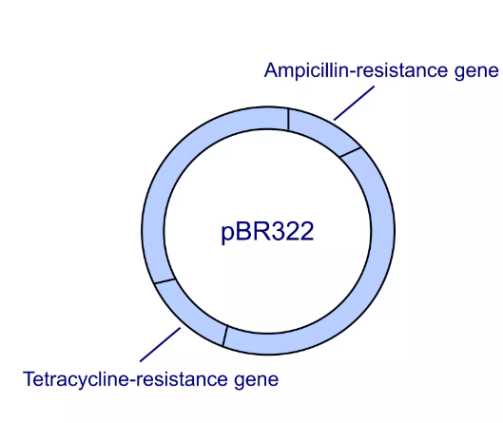
Plasmids
Plasmids are small circular double-stranded DNA molecules that replicate independently of the chromosomal DNA.
Plasmids contain one or more antibiotic-resistance genes.
They are present in prokaryotes (e.g. E. coli) in addition to the chromosomal DNA.
These genes provide antibiotic-resistance to the bacteria.
Plasmids can be transferred from one bacterium to another.
e.g. pUC18, pBR322

Slide 11
Restriction Enzymes
A restriction enzyme is a protein isolated from bacteria that cleaves DNA sequences at sequence-specific sites, producing DNA fragments with a known sequence at each end.
Hundreds of restriction enzymes have been discovered so far
They protect the bacteria against viral infections
When a virus infects a bacterial cell, restriction enzymes split the viral DNA thus, the virus is destroyed
Each restriction enzyme: Recognizes a specific base sequence in double-stranded DNA
Splits the DNA at this site called the restriction site yielding restriction fragments.
They are named after the bacterium in which they are found e.g. Hin I, Hae III, Eco RI
These enzymes serve as molecular scissors to cut DNA into defined fragments
Restriction endonucleases cleave DNA strands in the middle whereas exonuclease cleaves nucleic acid strands from the ends.

Slide 12
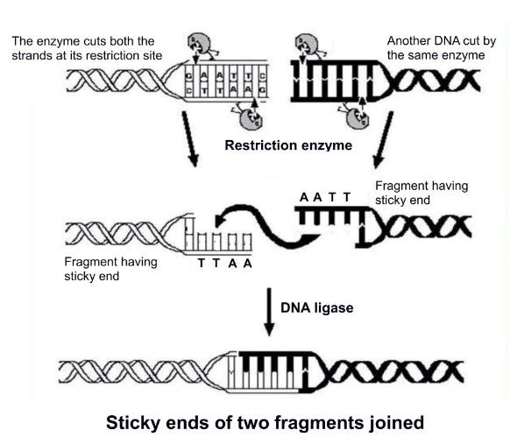
DNA Ligase
DNA ligases are the enzymes that are used to join (ligate) DNA fragments
The DNA ligase joins two DNA strands by forming a phosphodiester bond between them.
It is known as a molecular glue.
It is used to join genes of interest with the cloning vector.
e.g. T4 DNA ligase is used in rDNA technology.

Slide 13
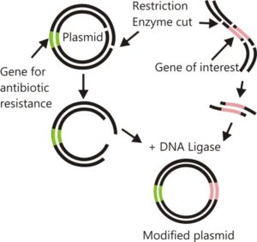
Recombinant DNA is the method of joining two or more DNA molecules to create a hybrid.
Enzymes used in rDNA Technology
The technology is made possible by two types of enzymes, restriction endonucleases, and ligase.
A restriction endonuclease recognizes a specific sequence of DNA and cuts within, or close to, that sequence. E.g. EcoRI
DNA fragments generated by digestion with a restriction endonuclease can be joined together again by the enzyme ligase (e.g. T4 DNA ligase).

Slide 14
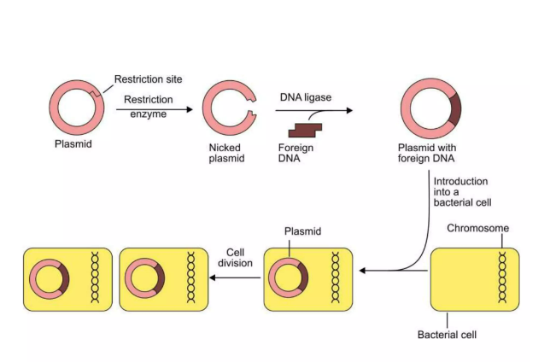
Host organism
The organism in which the gene of interest (with or without vector) is inserted and multiplied is known as the host organism.
Escherichia coli is commonly used for multiplication of various genes.

Slide 15
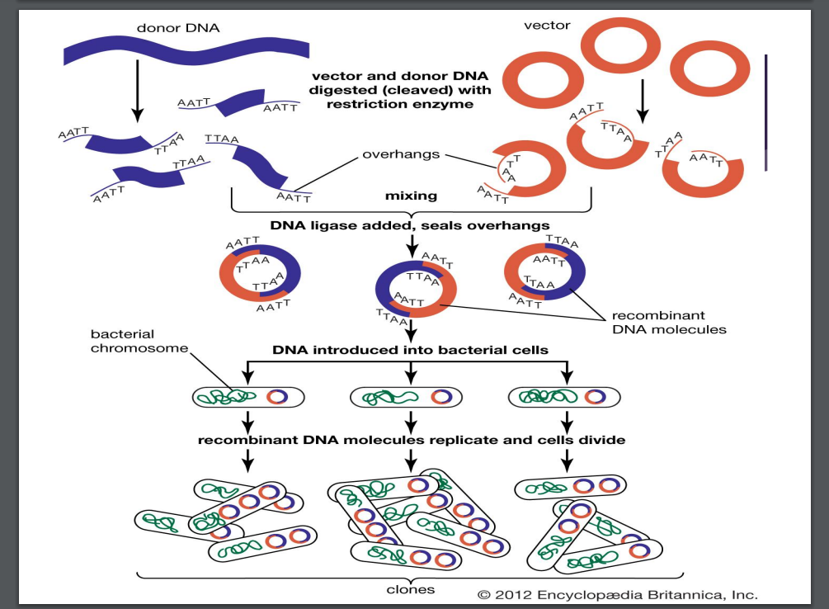
rDNA Cloning
DNA cloning is a molecular biology technique that is used for the creation of exact copies or clones of a particular gene or DNA.
The DNA molecules produced through the cloning techniques are used for many purposes, which include:
DNA cloning can be used to make proteins such as insulin with biomedical techniques.
It is used to develop recombinant versions of the non-functional gene to understand the functioning of the normal gene. This is applied in gene therapies also.
It helps to analyze the effect of mutation on a particular gene.

Slide 16
Step 1
Step 2
Step 3
The DNA fragment containing the gene sequence to be cloned (also known as the gene of insert) is isolated.
Cutting DNA with the help of restriction enzymes
Transformation: Insertion of these DNA fragments into the host cell using a “vector” (carries DNA molecule).
Step 4
Selection: Selection of the host cells carrying the rDNA molecule using a marker.
Step 5
Cloning of rDNA: The rDNA molecules are generated when the vector self-replicates in the host cell.
Step 6
Isolation of rDNA or its product
Step 7
Testing of biological properties of gene of interest
Insert gene of interest into vector with the help of ligases

Slide 17
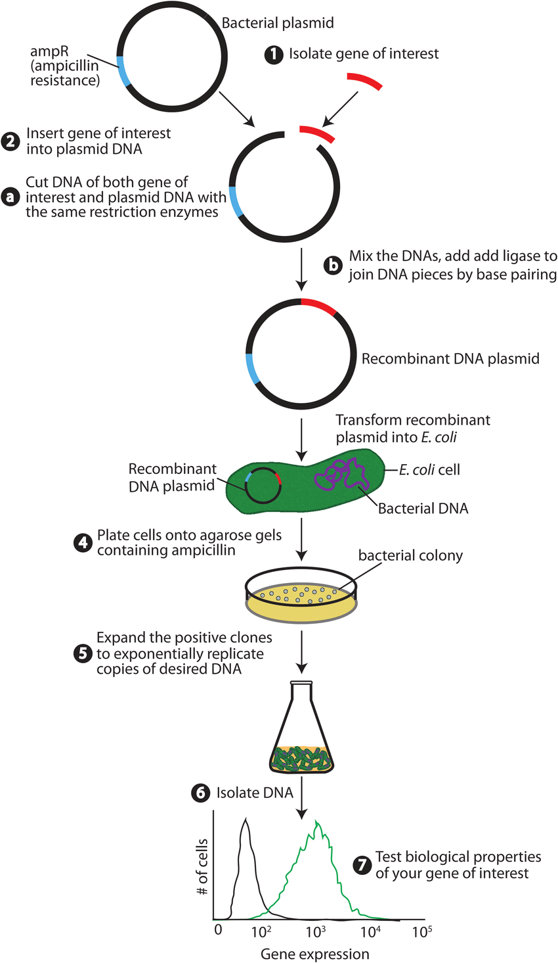
Bacterial plasmids with a resistance gene present (usually ampicillin or kanamycin-resistant) are used as vector DNA
(1) Isolate the DNA sequence gene of interest.
(2) Insert your DNA of interest into the vector plasmid:
(3) Put recombinant plasmid into E. coli by transformation.
(4) Clone cells:
(5) Pick colonies and inoculate a large culture to expand the plasmid carrying the gene of interest.
(6) Isolate and clean the DNA from the expanded culture.
(7) Transfer the plasmid DNA to desired cells (e.g., bacteria, yeast, mammalian cells, etc.) and test the biological properties of the gene of interest.
(a) cut both vector DNA and gene of interest with the same restriction enzymes
(b) mix the DNAs: they join by base pairing,
Steps for Recombinant DNA Technology
(c) add DNA ligase to bond the pieces covalently. The result is a recombinant plasmid.
(a) plate cells onto agar containing ampicillin (or kanamycin)
(b) each colony contains the recombinant plasmid by its ability to grow in the presence of ampicillin in the agar.

Slide 18
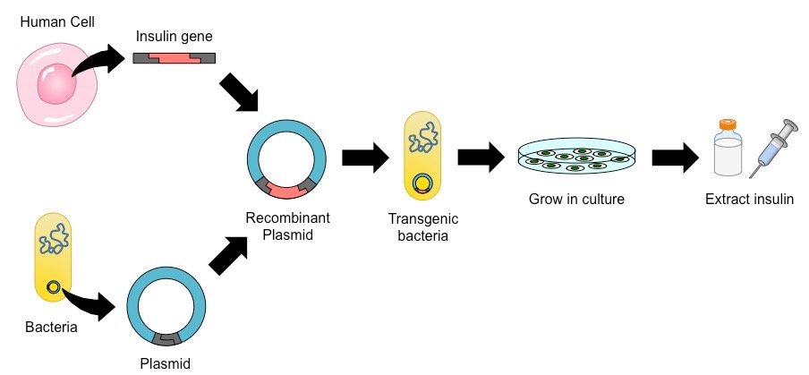
Applications of recombinant DNA in genetic engineering are:
For the production of vaccines like the hepatitis B vaccine.
Production of transgenic plants with improved qualities like insect and drought resistance and nutritional enrichment.
Therapeutic protein production like insulin.
Gene therapy in diseases like cancer, SCID etc.
Production of transgenic animals with improved quality of milk and egg.
Production of an Insulin

Slide 19
Agriculture:
Genetically modified crops
Resistance to diseases, insects and pests, herbicides, drought; metal toxicity tolerance; induction of male sterility for plant breeding purposes; and improvement of quality can be achieved through this recombinant DNA technology.
Pharmacology:
Large-scale production of human hormones and other proteins with therapeutic uses
Production of safer vaccines
Medicine:
Human Gene Therapy
Production of antibiotics, hormones, vaccines and interferon
A number of therapeutic gene products —insulin, interleukins, interferons, growth hormones, erythropoietin, and coagulation factor VIII—are now produced commercially from cloned genes
Diagnosis of genetic disorders
Forensic Evidence
“Golden rice” with beta-carotene which is required to make vitamin A, helps to prevent blindness
BT-cotton, resistant to bollworms; Herbicide or pesticide-resistant corn & soybean
Production of Antibiotics like Penicillium and Streptomyces
Production of Hormone Insulin

Slide 20
Gene Therapy
Gene therapy is a technique that involves the replacement of defective genes with healthy ones in order to treat genetic disorders.
It is an artificial method that introduces DNA into the cells of the human body.
It is used in the replacement of genes that cause medical ill-health
The method generally destroys the problem causing genes
It helps the body to fight against diseases by adding genes to the human body
This method is employed to treat diseases such as cancer, ADA deficiency, cystic fibrosis, etc.
In some genetic disorders, patients lack the functional form of a particular gene. Gene therapy attempts to provide a normal copy of the gene to the cells of a patient’s body.
Application of Gene Therapy
For example, DNA cloning was used to build plasmids containing a normal version of the gene that's nonfunctional in cystic fibrosis.
When the plasmids were delivered to the lungs of cystic fibrosis patients, lung function deteriorated less quickly.

Slide 21
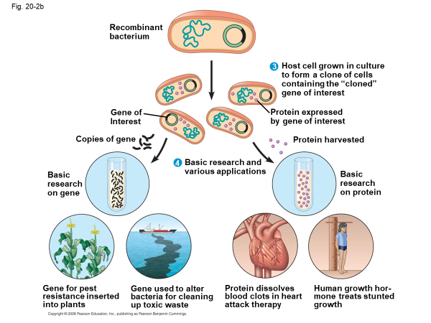

Slide 22
Stem Cell Biology

Slide 23
Stem cells are one of most fascinating areas of biology today
Stem cells are a specific type of cell capable of evolving into many different types of specialized cells within the body.
Due to their ability to repair, regenerate, and develop into certain specialized cell types, stem cells offer great promise as therapy for a number of diseases.
Research on stem cells is going on, and it is believed that stem cell therapies can cure ailments like paralysis and Alzheimer’s as well.
They serve as a repair system for the body.

Slide 24
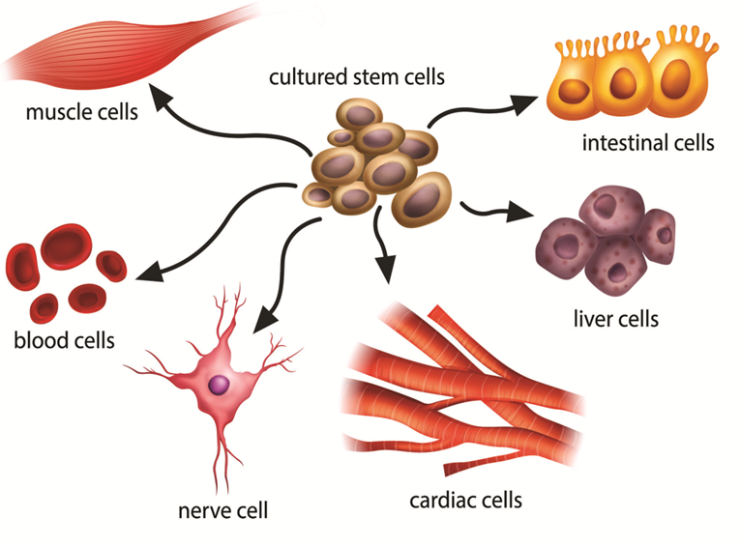
Stem Cells
Stem cells which are the undifferentiated master cells have the ability to continuously divide and develop into various other kinds of cells.

Slide 25
Stem cells are different from other cells in the body in three ways:
Proliferation: They can divide and renew themselves over a long time
Differentiation: They are unspecialized, so they cannot do specific functions in the body
Plasticity: They have the potential to become specialized cells, such as muscle cells, blood cells, and brain cells

Slide 26
There are two major sources of stem cells:
Embryonic stem cells and adult stem cells are also called tissue stem cells.
Embryonic stem (ES) cells are stem cells that are derived from the inner cell mass of a mammalian embryo at a very early stage of development, when it is composed of a hollow sphere of dividing cells (a blastocyst).
Adult stem cells: Some tissues in the adult body, such as the epidermis of the skin, the lining of the small intestine, and bone marrow, undergo continuous cellular turnover.
They contain stem cells, which persist indefinitely, and a much larger number of “transit amplifying cells,” which arise from the stem cells and divide a finite number of times until they become differentiated.

Slide 27
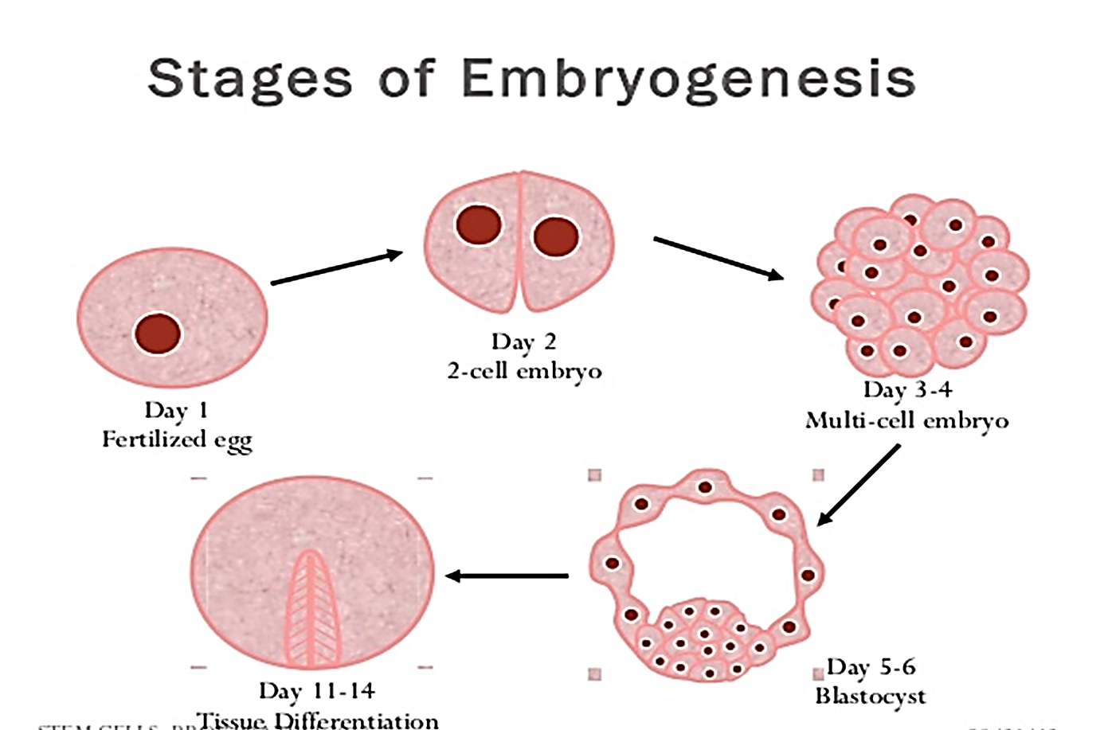
Embryonic stem cells
Embryonic stem cells (often referred to as ES cells) are stem cells that are derived from the inner cell mass of a mammalian embryo at a very early stage of development, when it is composed of a hollow sphere of dividing cells (a blastocyst).

Slide 28
Adult stem cells: Depending upon the source of their origin they are of different types
Hematopoietic stem cells (HSCs): These are found in bone marrow and are a continuous source of progenitors of red cells, platelets, monocytes, granulocytes and lymphocytes.
Mesenchymal stem cells or Marrow stromal cells (MSCs): These are also isolated from bone marrow and, in culture can differentiate into osteoblasts, chondrocytes, adipocytes, and even myoblasts.
Neural stem cells: These are isolated from the central nervous system (CNS) and have the potential to differentiate into neurons, astrocytes, and oligodendrocytes. There are other kinds of stem cells.
Umbilical cord and Placental stem cell: These are isolated from umbilical cord and placenta. It is relatively easy to collect, with no risk to the mother or baby. It contains haematopoietic (blood) stem cells.

Slide 29
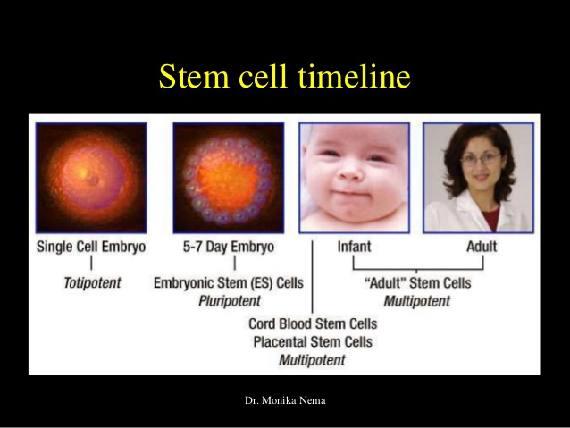

Slide 30
Types of Stem Cells
There are 5 major types:
Pluripotent Stem Cells: These are the cells from an early embryo (blastocyst 5-14 days) and can differentiate into over 200 types of cell type.
Totipotent Stem Cells: These can differentiate into all possible types of cells.
These types of cells are found in plants and in early embryos (1-3 days)
Each cell can form a complete organism.
Multipotent Stem Cells: These differentiate into a closely related cell type.
e.g., the hematopoietic stem cells differentiate into red blood cells and white blood cells.
Unipotent Stem Cells: They can produce cells only of their own type. Since they have the ability to renew themselves, they are known as unipotent stem cells.
e.g., Muscle stem cells.
Oligopotent Stem Cells: Adult lymphoid or myeloid cells are oligopotent. They can differentiate into a few different types of cells.

Slide 31
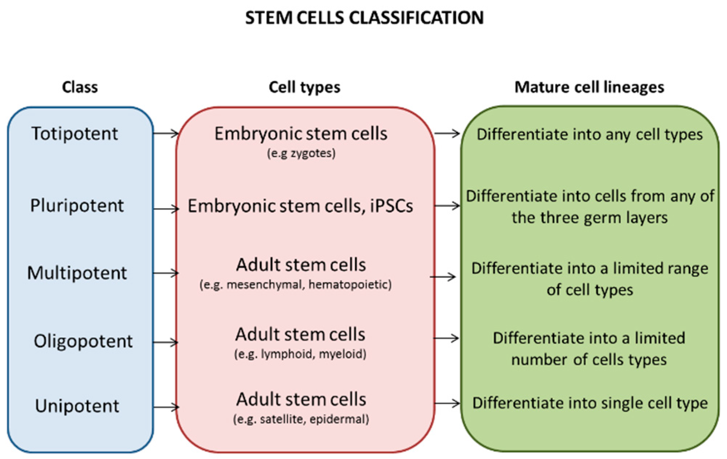

Slide 32
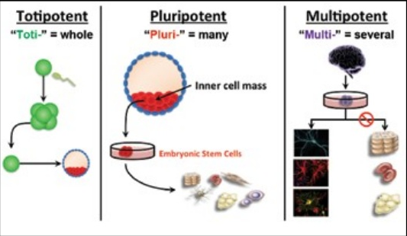

Slide 33
Application of Stem Cell
Basic research: Clarification of complex events that occur during human development and understanding molecular basis of cancer
Biotechnology (drug discovery and development): Stem cells can provide specific cell types to test new drugs
Tissue Regeneration: This is the most important application of stem cells. The stem cells can be used to grow a specific type of tissue or organ.
This can be helpful in kidney and liver transplants.
The doctors have already used the stem cells from beneath the epidermis to develop skin tissue that can repair severe burns or other injuries by tissue grafting.

Slide 34
Application of Stem Cell
Treatment of Brain Diseases: Stem cells can also treat diseases such as Parkinson’s disease and Alzheimer’s.
Cancer treatment: They are applied especially to treat cancers, which require high-dose chemotherapy within the scope of medical care.
The patient’s own stem cells are extracted from bone marrow or peripheral blood prior to high-dose chemotherapy, stored temporarily and transplanted after the treatment in order to minimize the side effects of the aggressive chemotherapy and to support the regeneration of destroyed cells.
These can help to replenish the damaged brain cells.
Researchers have tried to differentiate embryonic stem cells into these types of cells and make it possible to treat diseases.

Slide 35
Areas of active research on stem cell biology
Treating liver disease with stem cells that have been manipulated to become specialized liver cells
Creating stem cell-derived neurons for the study of motor neuron disease
Creating insulin-producing pancreatic beta cells for clinical trials in diabetes
Stimulating an anti-brain tumor immune response via manipulated stem cells
Investigating the use of stem cells to study and treat Gaucher disease and parkinsonism
Reprogramming tumor-specific immune cells from stem cells for cancer immunotherapy
Manipulating stem cells to become bone and cartilage

Slide 36
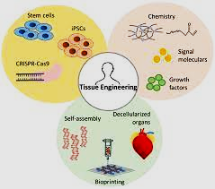
Tissue Engineering
An interdisciplinary field that applies the principles of engineering and life sciences toward the development of biological substitutes that restore, maintain, or improve tissue functions or a whole organ.

Slide 37
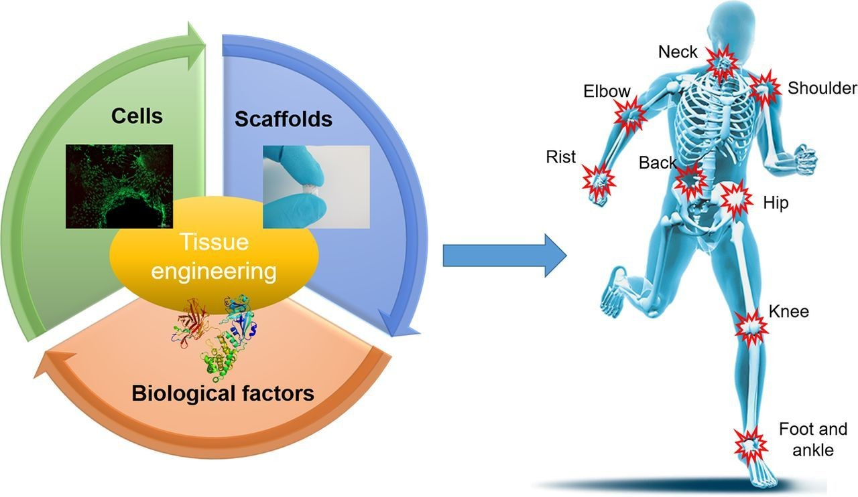
TISSUE ENGINEERING
Tissue engineering utilizes living cells as engineering materials.
The goal of tissue engineering is to assemble functional constructs that restore, maintain, or improve damaged tissues or whole organs.
Tissue engineering evolved from the field of biomaterials development and refers to the practice of combining scaffolds, cells, and biologically active molecules into functional tissues.
Artificial skin and cartilage are examples of engineered tissues; however, currently they have limited use in human patients.

Slide 38
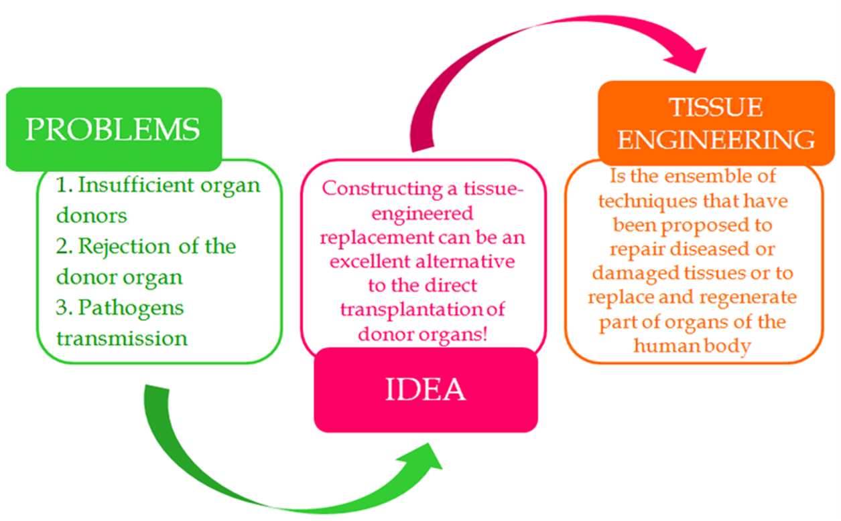
Why do we need Tissue Engineering?

Slide 39
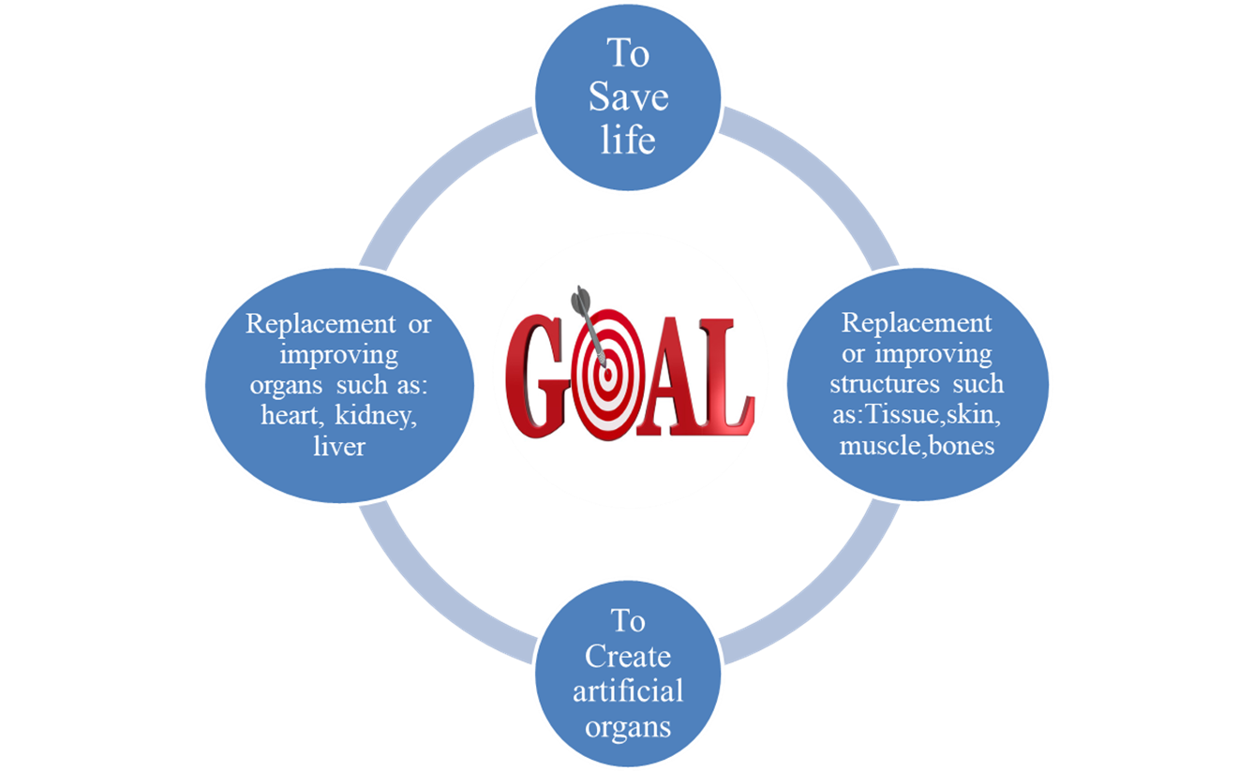
GOALS OF TISSUE ENGINEERING

Slide 40
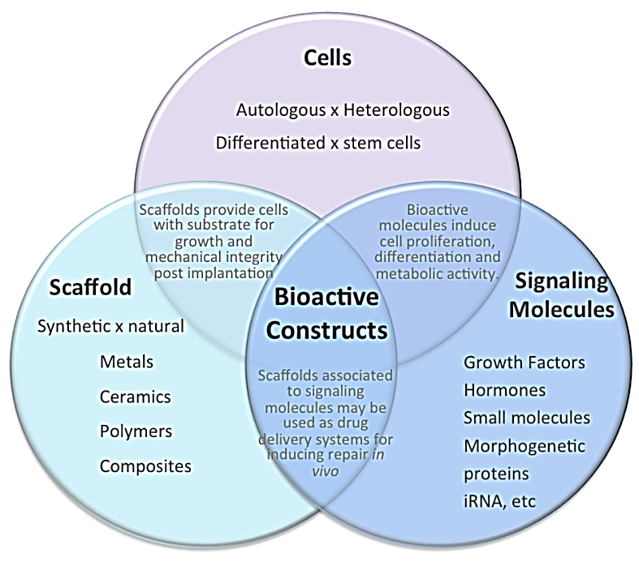
Tools of Tissue Engineering
Three tools of tissue engineering
Cell
Living part of the tissue
Produce proteins and provide functions of cell
Scaffold
Provides structural support and shape to construct
Provide place for cell attachment and growth
Usually biodegradable and biocompatible
Cell signalling
Signals that tell the cell what to do
Protein and mechanical stimulation
Growth factors

Slide 41
Cell
Cells are often categorized by their source:
Autologous cells- obtained from same source to which they will be implanted. Have fewest problem of rejection and pathogen transmission
Allogenic cells- comes from body of same donor species
Xenogenic cells- isolated from individuals of other species, like use of animal cells for cardiovascular implants
Isogenic cells- isolated from genetically identical organisms like twins, clones
Stem cells- undifferentiated cells with the ability to divide in culture , give rise to different specialized cells . Can be multipotent, pluripotent and totipotent

Slide 42
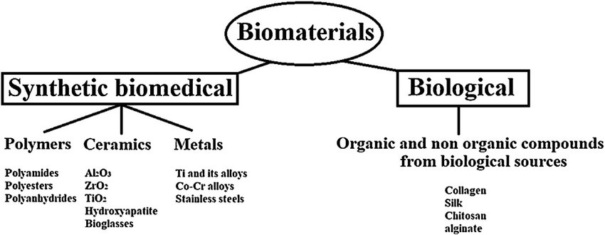
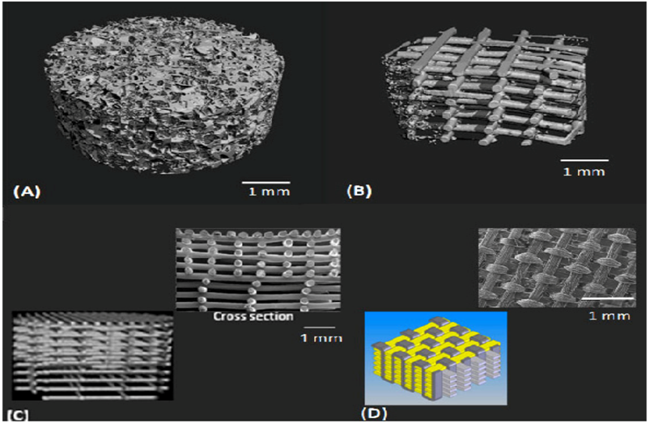
Scaffolds
Scaffolds are structures manufactured for the sole purpose of allowing cells to grow
Key elements of scaffolds and cell development
Structures that are enable to support 3-D cell structures
Allow for cell attachment, migration, and growth
Enable diffusion of cell nutrients
Allow the manipulation of cells to form as correctly shaped

Slide 43
Signalling Molecules
Hormones: Secreted by endocrine glands, by dispersed glandular cells.
Neurohormones: Secreted by Neurons into blood circulation.
Neurotransmitters: Secreted by neurons at nerve endings.
Cytokines: Secreted by immune-competent cells.
Growth Factors: Secreted by various types of cells.

Slide 44
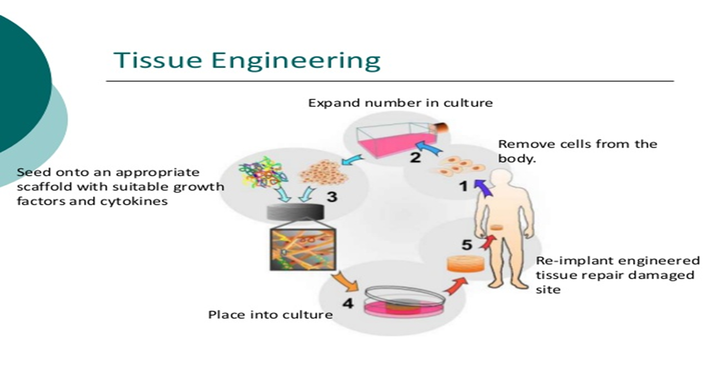
Steps of Tissue Engineering
Isolated cells are taken to the culture system and cultivated to selective cell differentiation time
Different biomaterials are used for constructing scaffolds
Different techniques are used for scaffold fabrication
For in vitro tissue engineering tissue culture is done either on petri dishes or bioreactors

Slide 45
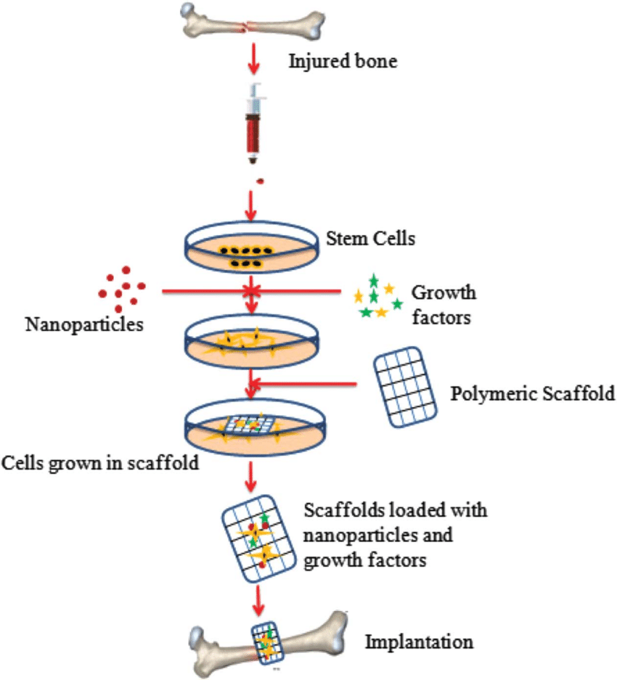
APPLICATIONS OF TISSUE ENGINEERING
Replacing the old cell: When there is damage in our body cells or organs we use tissue engineering techniques to overcome the damage by replacing the old cell.
Regenerative Medicines: Regenerative medicines repair damaged tissues and organs.
They stimulate the body’s own repair mechanisms to heal previously irreparable tissues or organs.
If the body cannot heal itself, the tissues or organs can be grown in the laboratory and then implanted.
Regenerative Medicine also involves the use of stem cells or progenitor cells obtained through directed differentiation

Slide 46
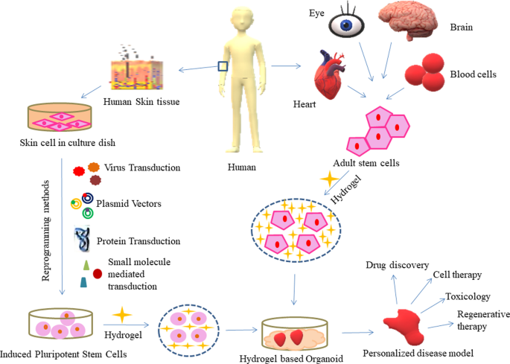
APPLICATIONS OF TISSUE ENGINEERING
Therapeutic Cloning: Bioartificial liver device, artificial pancreas, artificial bladders, and Cartilage.
There is a wide range of Tissue Engineered products or materials that are used to cure diseases in humans and save life.
Even if Tissue Engineering is life-saving, it is expensive.
Organ Transplantation: The transplantation of cells that perform a specific biochemical function (e.g. Artificial pancreas or Artificial liver).
Drug Discovery- For effective drug screening, 3D cultures are introduced to analyze the effect of drug action

Slide 47
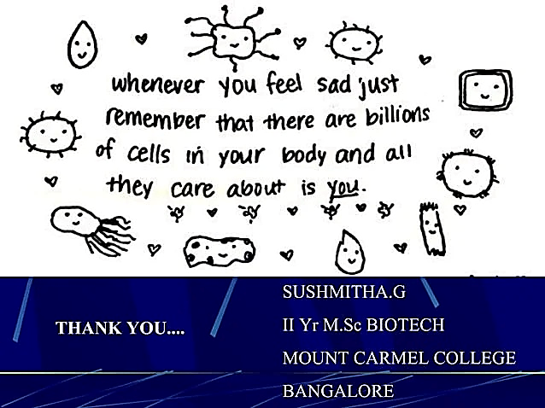

Slide 48
REFERENCES
C.B.Powar, 2010.Cell Biology.5th Ed,Himalyan Publishing House.
Sandhu, Sardul Singh. Recombinant DNA Technology. India: I.K. International Publishing House Pvt. Limited, 2013. John G. Webster 1998.
Principles of Tissue Engineering. Switzerland: Elsevier Science, 2000.
Jeremy M. Berg, John L. Tymoczko and Lubert Stryer. 2006. “Biochemistry,” 6th Ed. W.H. Freeman and Co. Ltd.
Robert Weaver. 2012 “Molecular Biology,” 5th Edition, MCGraw-Hill.
Concepts and Applications of Stem Cell Biology: A Guide for Students. Germany: Springer International Publishing, 2020.
Martin Alexander, 1994 “Biodegradation and Bioremediation,” Academic Press.

Slide 49
THANK YOU

